Slide 1
Microsoft 365 Enterprise
Licensing overview
March 2021
Latest diagrams available here:
https://m365maps.com

Slide 2
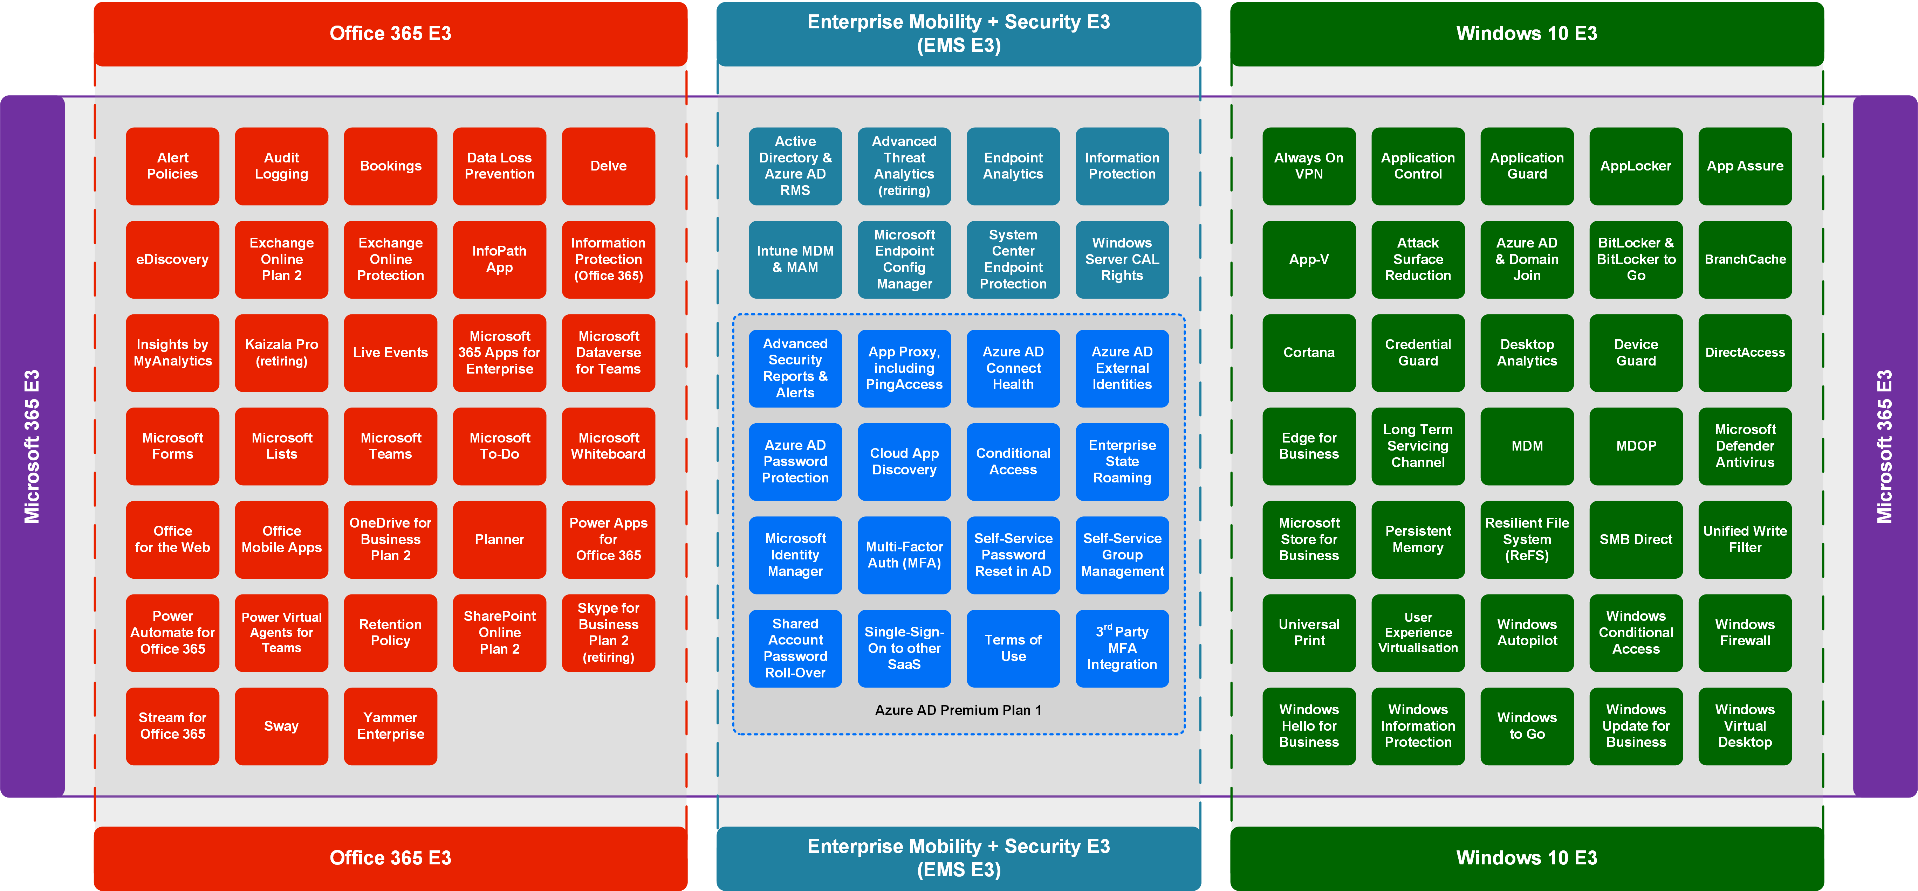
Latest diagrams available here: https://m365maps.com

Slide 3
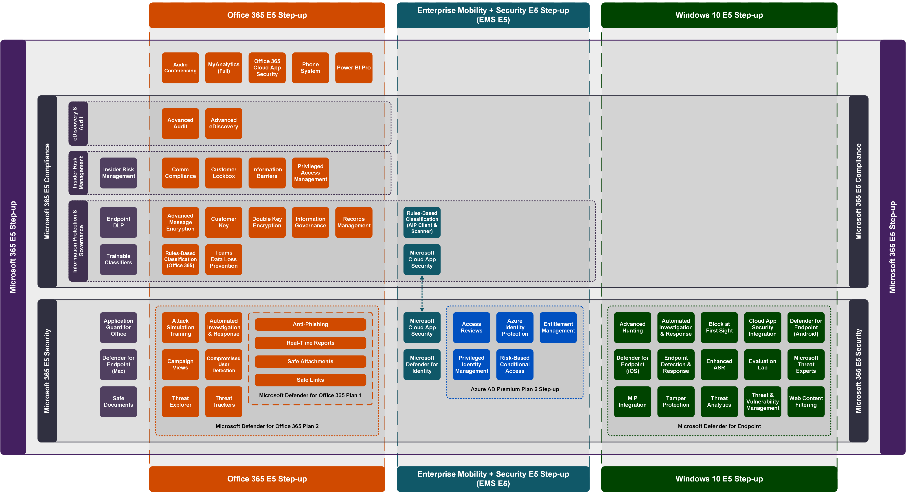
Latest diagrams available here: https://m365maps.com

Slide 4
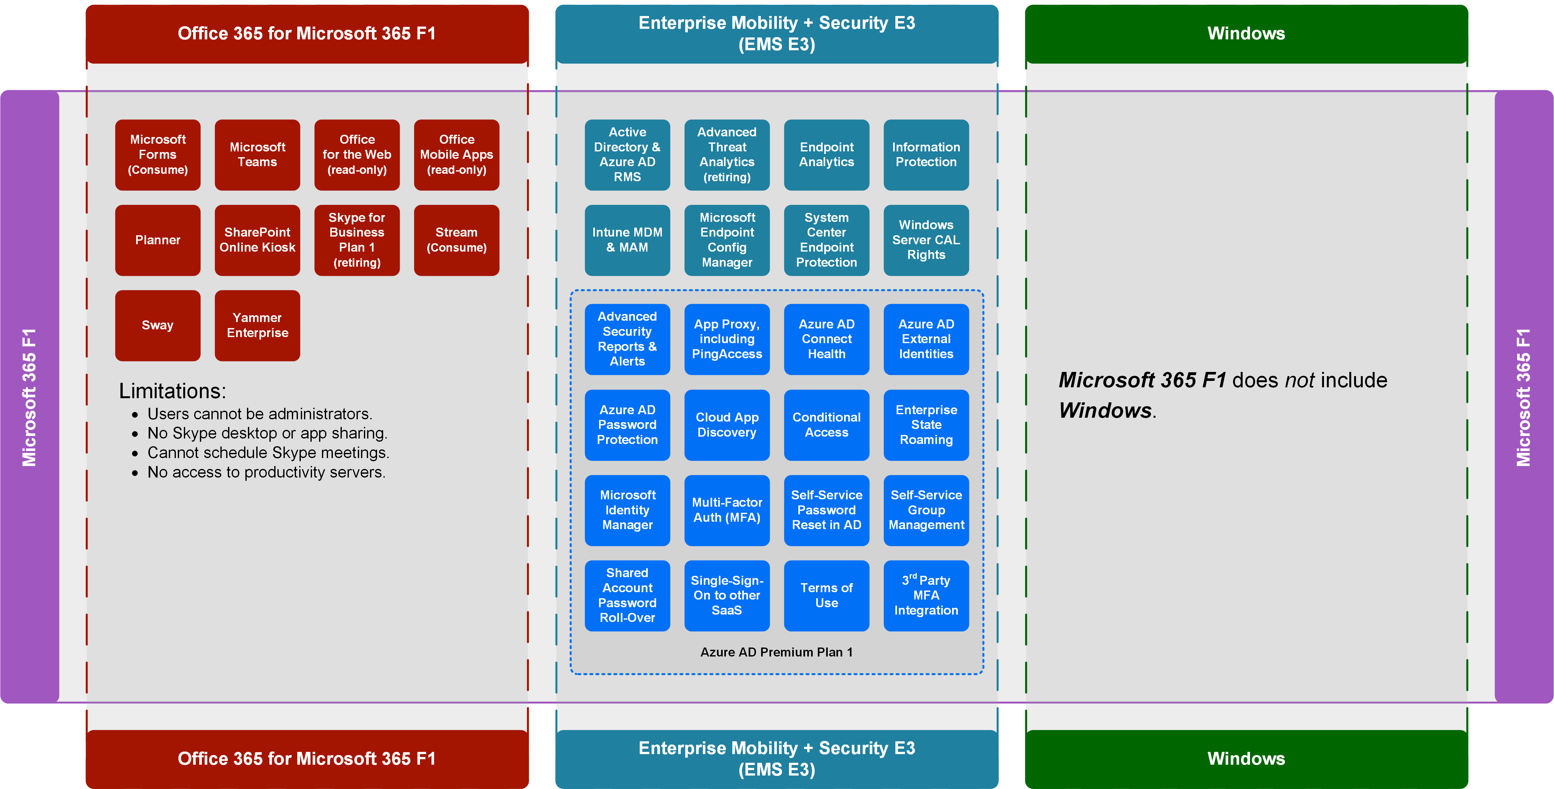
Latest diagrams available here: https://m365maps.com

Slide 5
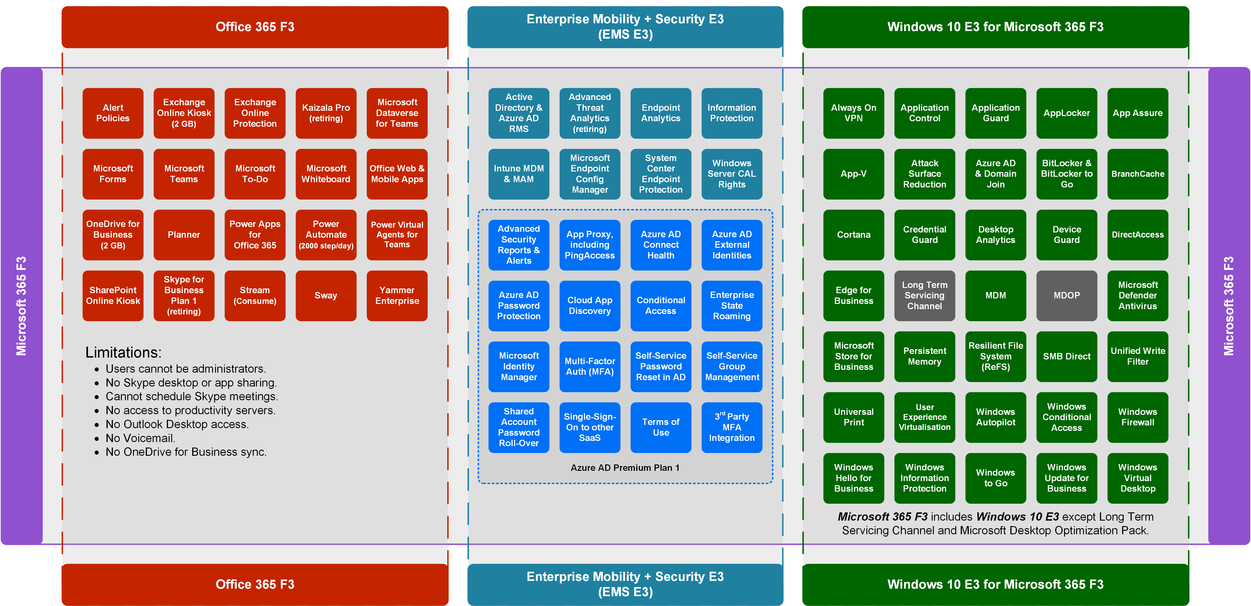
Latest diagrams available here: https://m365maps.com

Slide 6
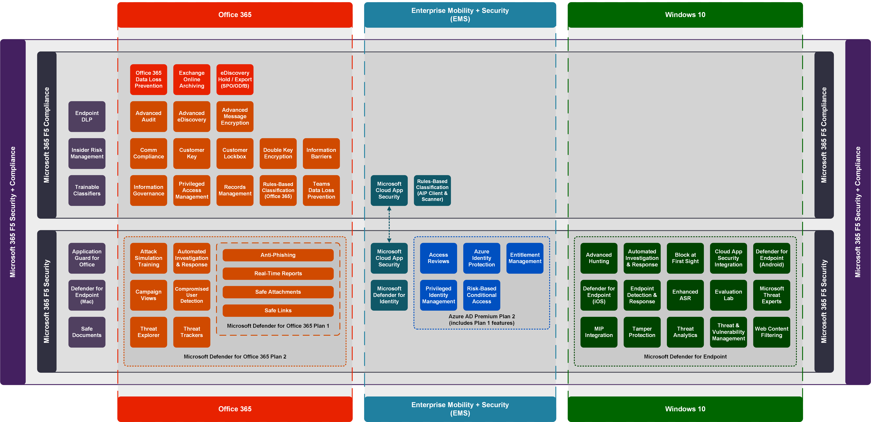
Latest diagrams available here: https://m365maps.com

Slide 7
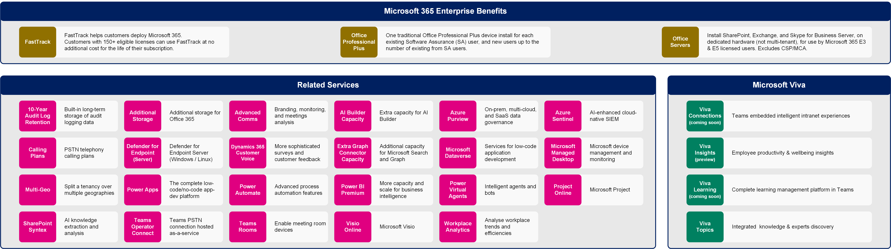
Microsoft 365 Enterprise Benefits, Microsoft Viva, and Related Services
Latest diagrams available here: https://m365maps.com

Slide 8
Website https://m365maps.com GitHub https://github.com/AaronDinnage/Licensing Updates on Twitter and LinkedIn https://twitter.com/AaronDinnage https://www.linkedin.com/in/aarondinnage/

